Slide 1
007-02-001A
Processing Date: 2023-01-03

Slide 2
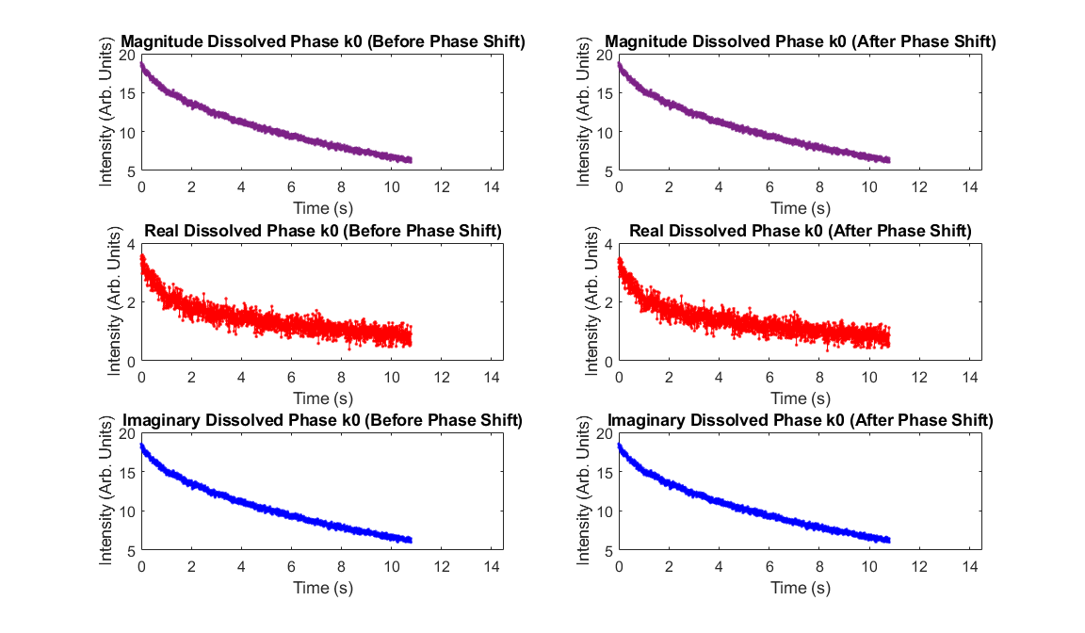
k0 for FIDs

Slide 3
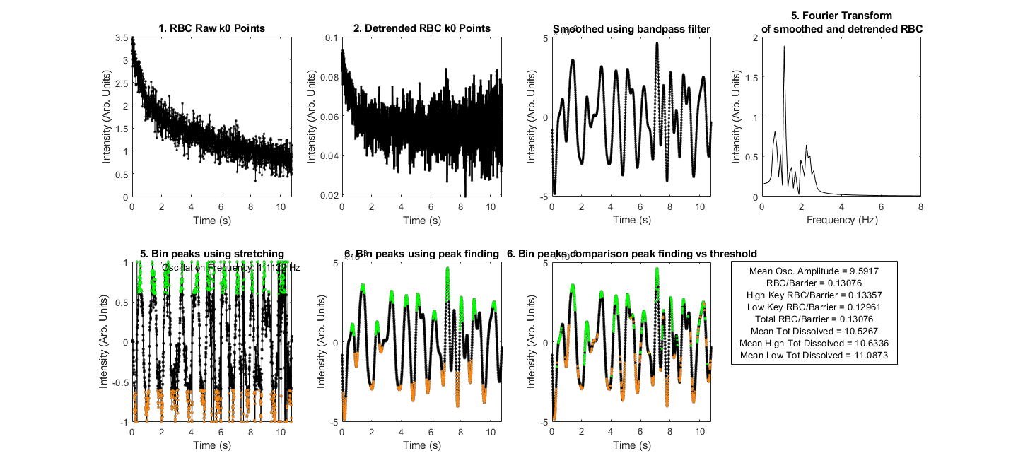
Binning Workflow

Slide 4
Image Characteristics
Gas SNR | 60.2106
Total Dissolved SNR | 29.87
High Dissolved SNR | 28.5436
Low Dissolved SNR | 28.5193
Total Barrier SNR | 31.5466
High Barrier SNR | 30.0794
Low Barrier SNR | 30.0528
Total RBC SNR | 5.5583
High RBC SNR | 5.4184
Low RBC SNR | 5.3509
GX Recon Dissolved SNR | 31.9518
Total RBC/Barrier | 0.18163
High RBC/Barrier | 0.18537
Low RBC/Barrier | 0.18341
Views Removed (Front) | 100
Views Removed (Back) | 0
Key Radius (nPts) | 9
GX Sequence | fast_dixon

Slide 5
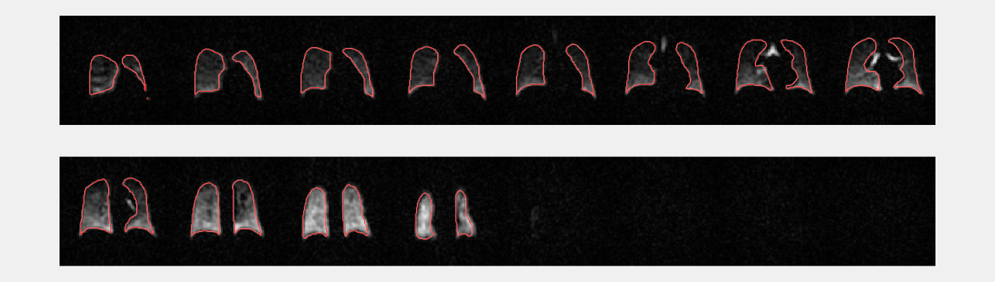
Proton Mask with Gas Image

Slide 6
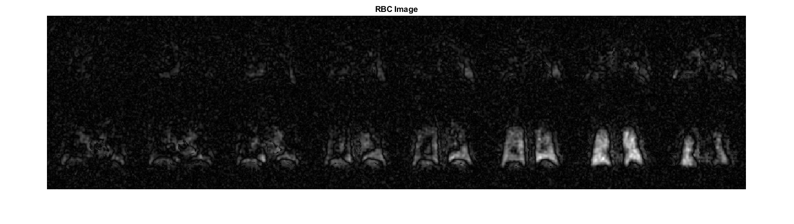
RBC Image

Slide 7
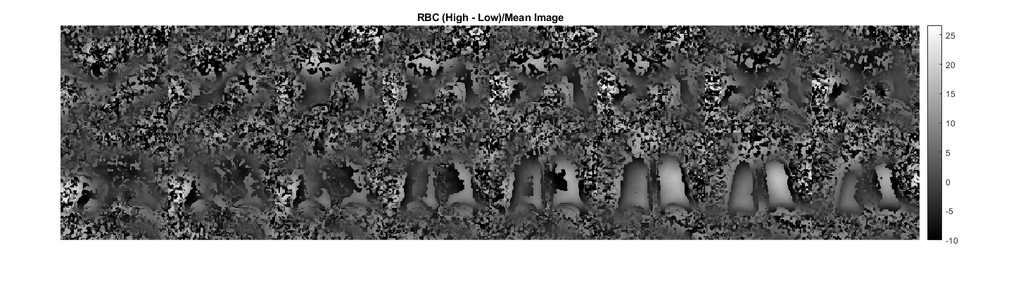
RBC (High - Low)/Mean Image

Slide 8
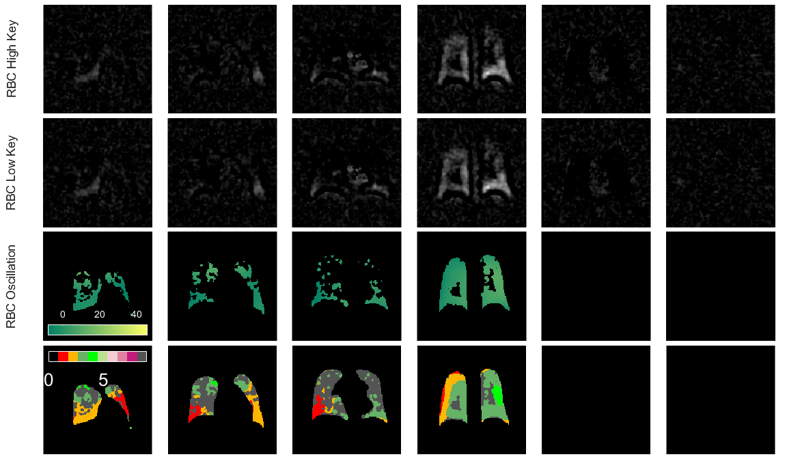
RBC Difference

Slide 9
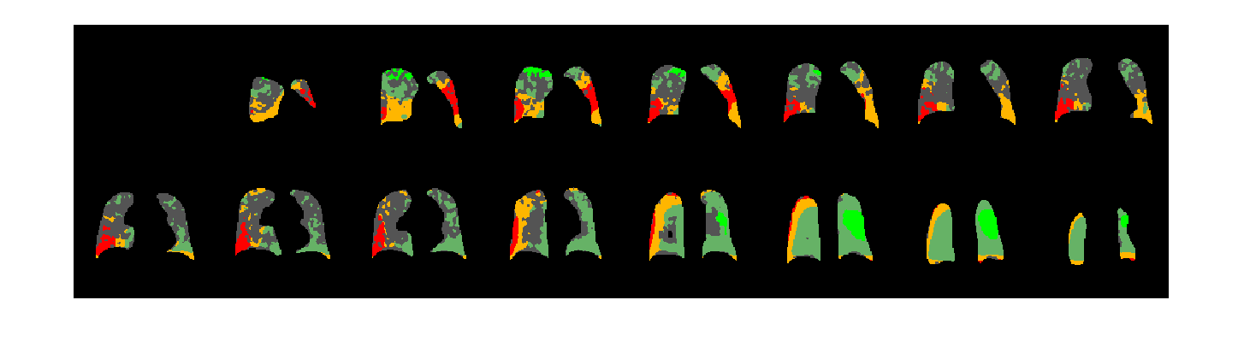
Binned RBC Oscillations Images for Subject 007-02-001A

Slide 10
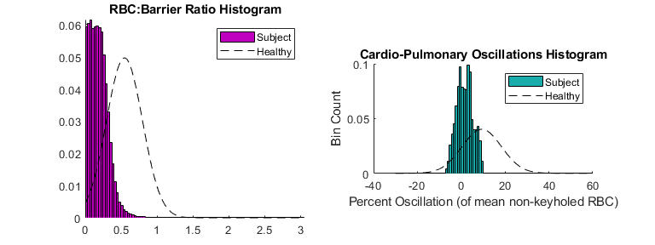
Whole Lung Histograms for Subject 007-02-001A

Slide 11
Oscillation Characteristics
Subject | 007-02-001A
Date | 2023-01-03
Mean oscillation Percent | 1.6573
Mean oscillation STD | 3.6657
Mean oscillation CV | 2.2118
MeanRBCMeasure | -2.2468
Total RBC SNR | 5.5583
% Low Oscillation (Red) | 7.4974
% Low Oscillation (Red-Orange) | 24.0536
% High Oscillation (Purple 1-3) | 0
% Low SNR (analysis ignored) | 40.1736
RBC:membrane | 0.13076

Slide 12
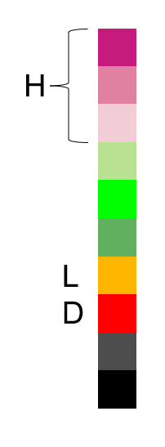
RBC Oscillation Analysis - Exploratory
Subject | 007-02-001A
Date | 2023-01-03
Mean oscillation Percent | 1.6573
Mean oscillation STD | 3.6657
Mean oscillation CV | 2.2118
MeanRBCMeasure | -2.2468
Total RBC SNR | 5.5583
% Low Oscillation (Red) | 7.4974
% Low Oscillation (Red-Orange) | 24.0536
% High Oscillation (Purple 1-3) | 0
% Low SNR (analysis ignored) | 40.1736
RBC:membrane | 0.13076
Binned Oscillations

